Slide 1
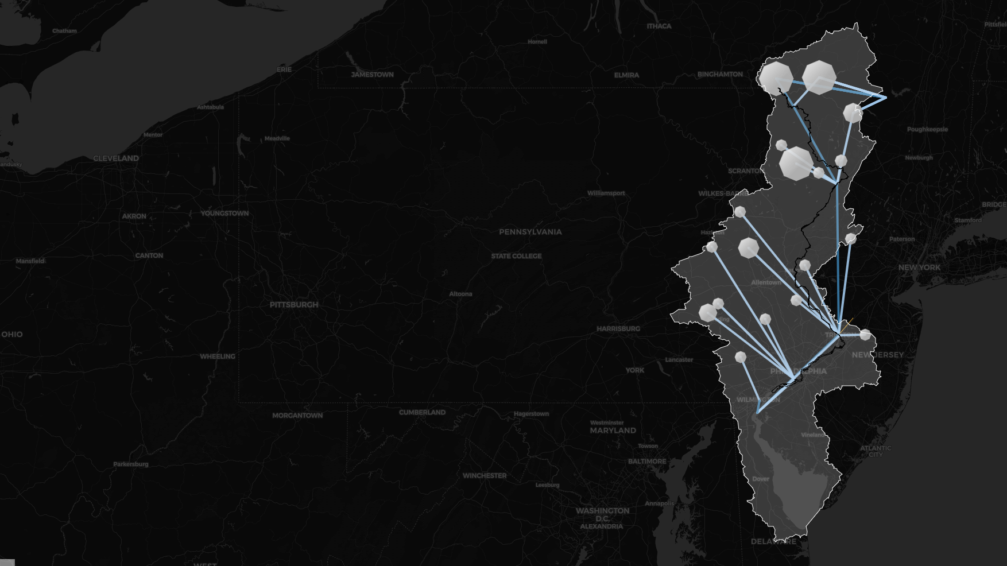
Assessing the Delaware River Basin’s Vulnerability to the 1960s Drought of Record
Trevor Amestoy*, Andrew Hamilton, Patrick Reed
Cornell University

Slide 2
Spoilers:
Motivation | The Delaware River Basin | Pywr-DRB | Streamflow Reconstruction | Drought Vulnerability Assessment
1
Stakeholders in the Delaware River Basin ask the question:
“What if the 1960s drought of record happened today, with current management policies?”

Slide 3
Spoilers:
Motivation | The Delaware River Basin | Pywr-DRB | Streamflow Reconstruction | Drought Vulnerability Assessment
1
Stakeholders in the Delaware River Basin ask the question: “What if the 1960s drought of record happened today, with current management policies?”
2
A new open-source water resource systems model helps us try to answer this question.

Slide 4
Spoilers:
Motivation | The Delaware River Basin | Pywr-DRB | Streamflow Reconstruction | Drought Vulnerability Assessment
1
Stakeholders in the Delaware River Basin ask the question: “What if the 1960s drought of record happened today, with current management policies?”
2
A new open-source water resource systems model helps us try to answer this question.
3
Results reveal the 1960s drought conditions present severe risk for the NYC water supply and downstream flow objectives.

Slide 5
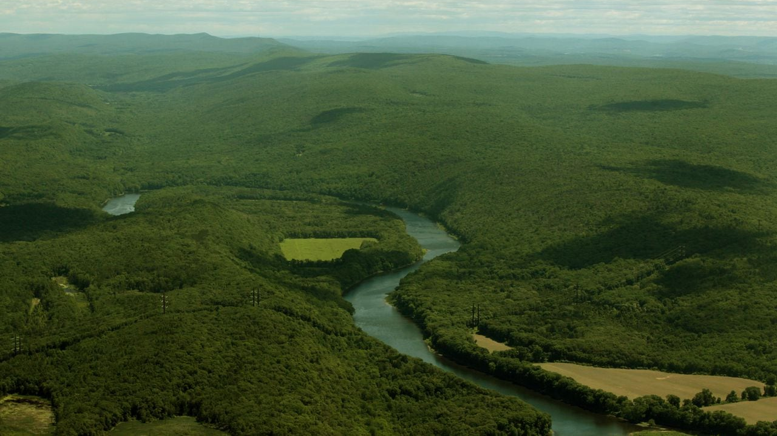
Motivation
Image: Delaware Water Gap; lehighvalleylive.com

Slide 6
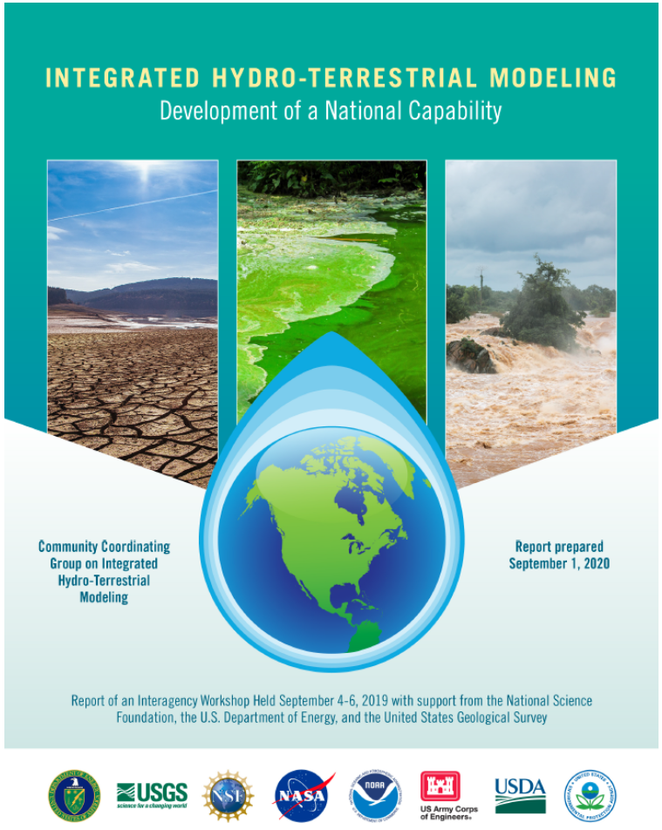
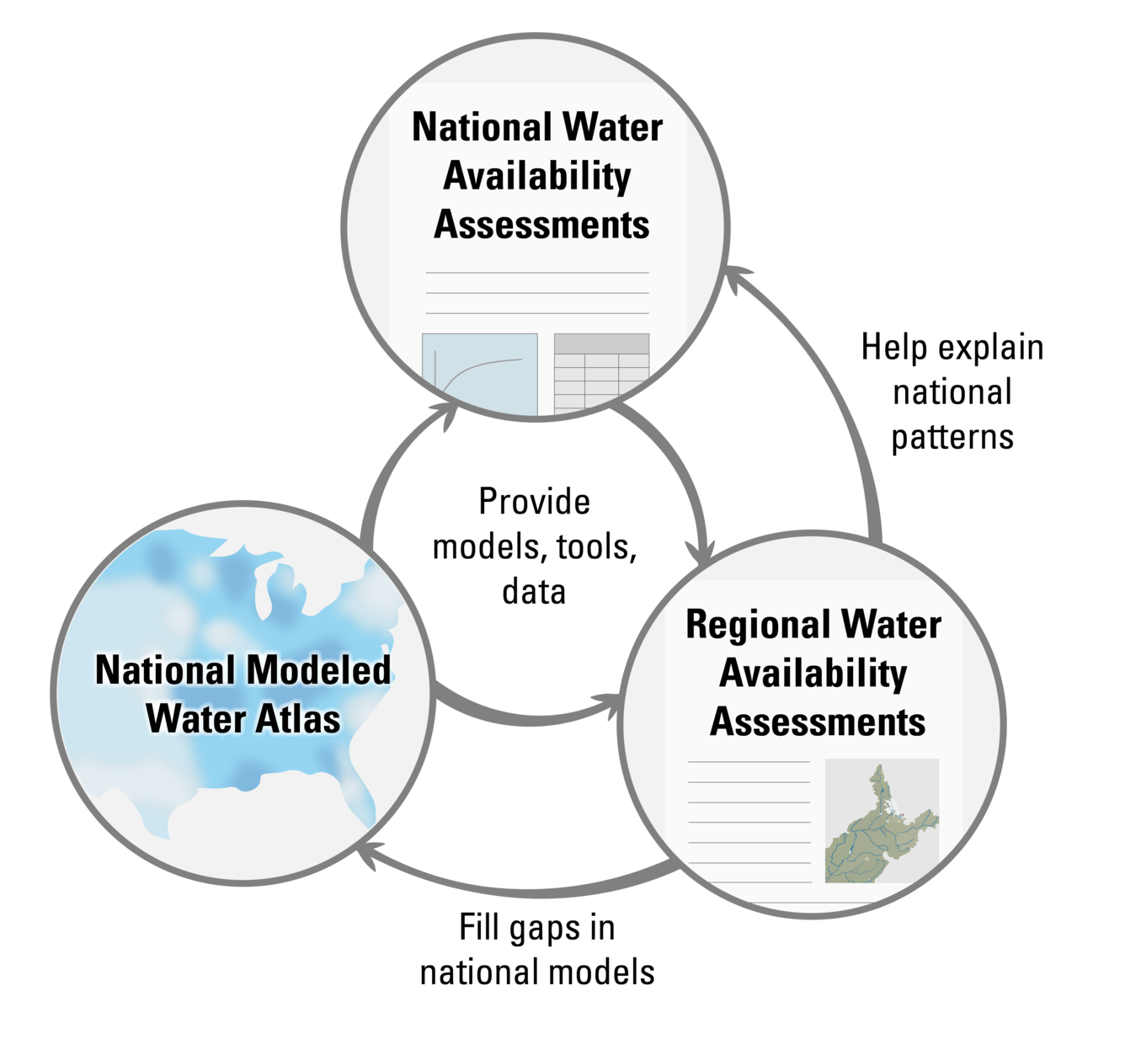
A national effort to improve water systems evaluations
Motivation | The Delaware River Basin | Pywr-DRB | Streamflow Reconstruction | Drought Vulnerability Assessment
Graphic source: USGS

Slide 7
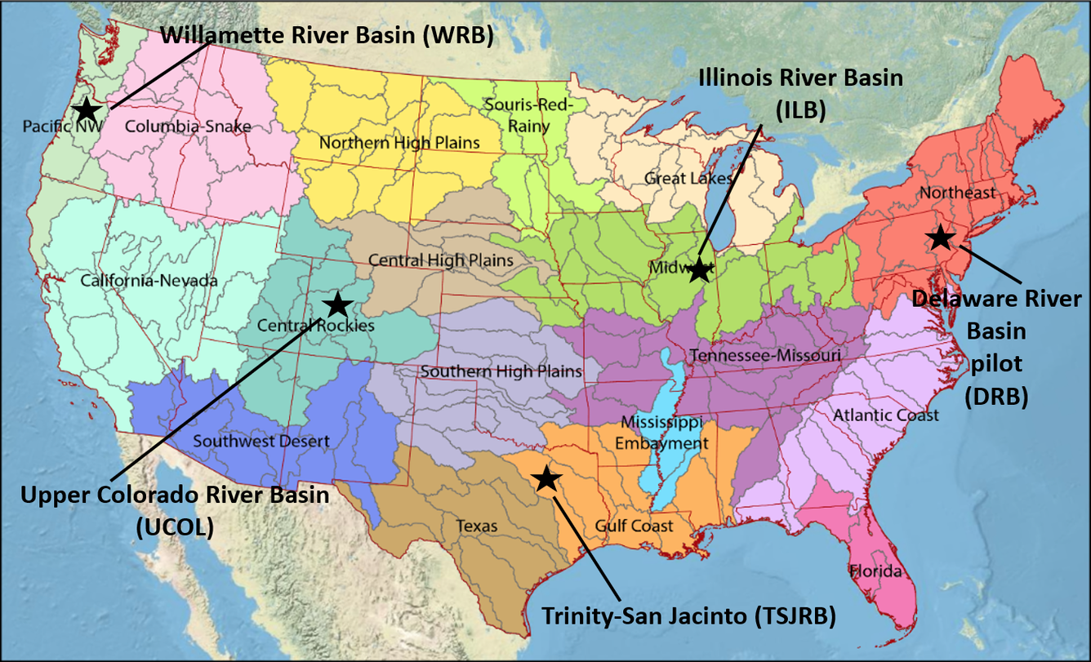
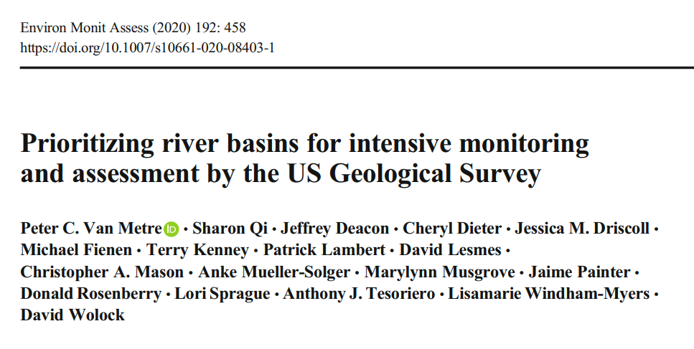
A national effort to improve water systems evaluations
Motivation | The Delaware River Basin | Pywr-DRB | Streamflow Reconstruction | Drought Vulnerability Assessment
The Delaware River Basin is the pilot study basin chosen for the first Regional Water Availability Assessment.

Slide 8
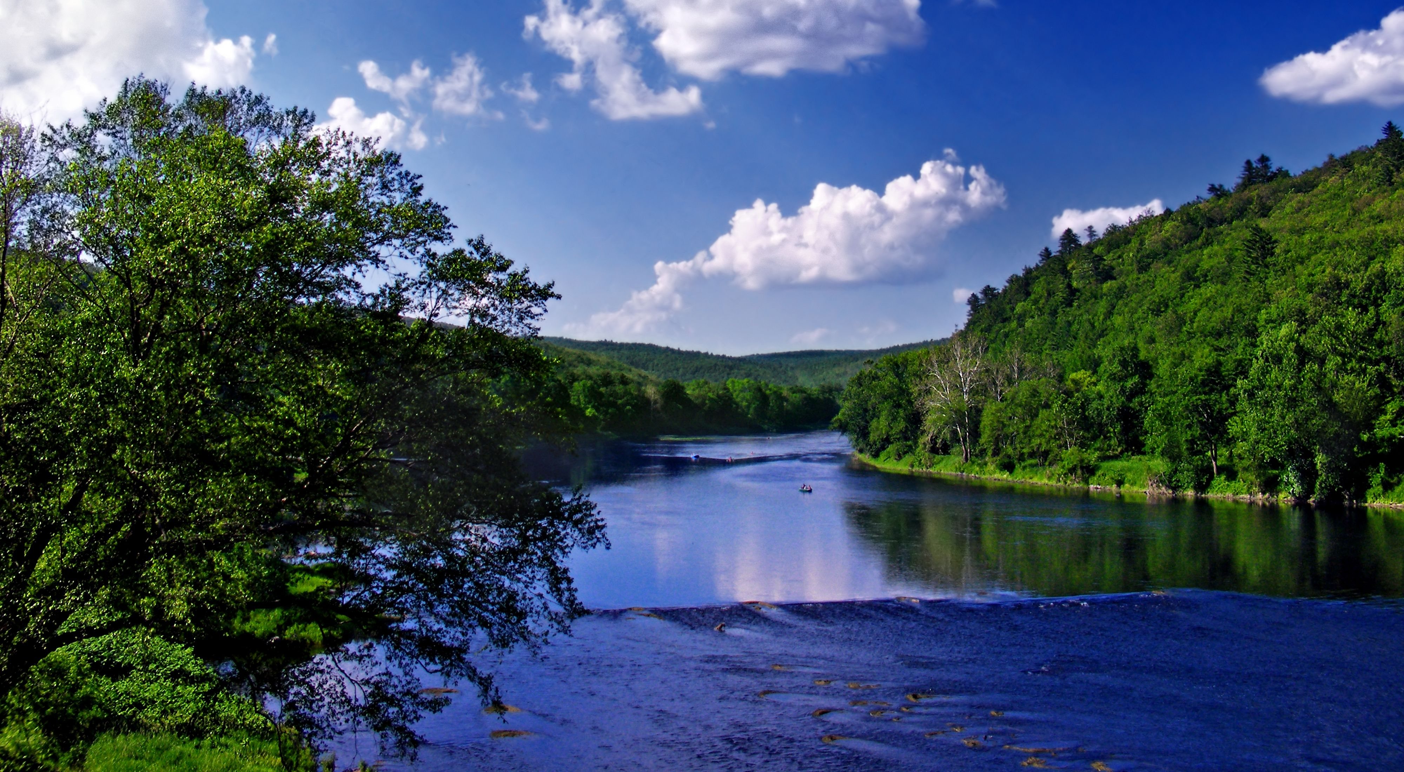
The Delaware River Basin
Photo credit: Nicholas A. Tonelli

Slide 9
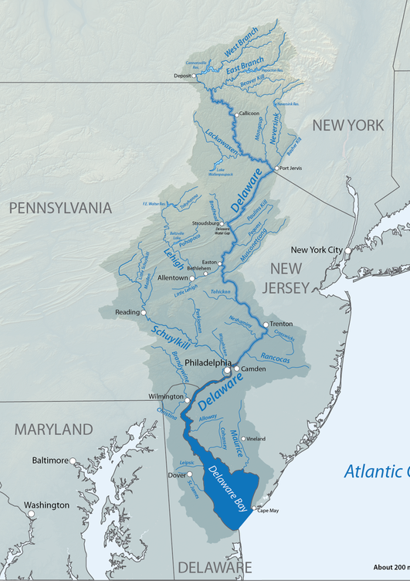




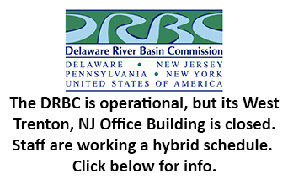




The Delaware River Basin (DRB)
Motivation | The Delaware River Basin | Pywr-DRB | Streamflow Reconstruction | Drought Vulnerability Assessment
You are here.
The DRB is collaboratively managed by:
Four states (NY, PA, NJ, DE)
New York City (NYC)
Federal agencies (USGS, USACE)
The DRB Commission (DRBC).
Source: americanrivers.org

Slide 10
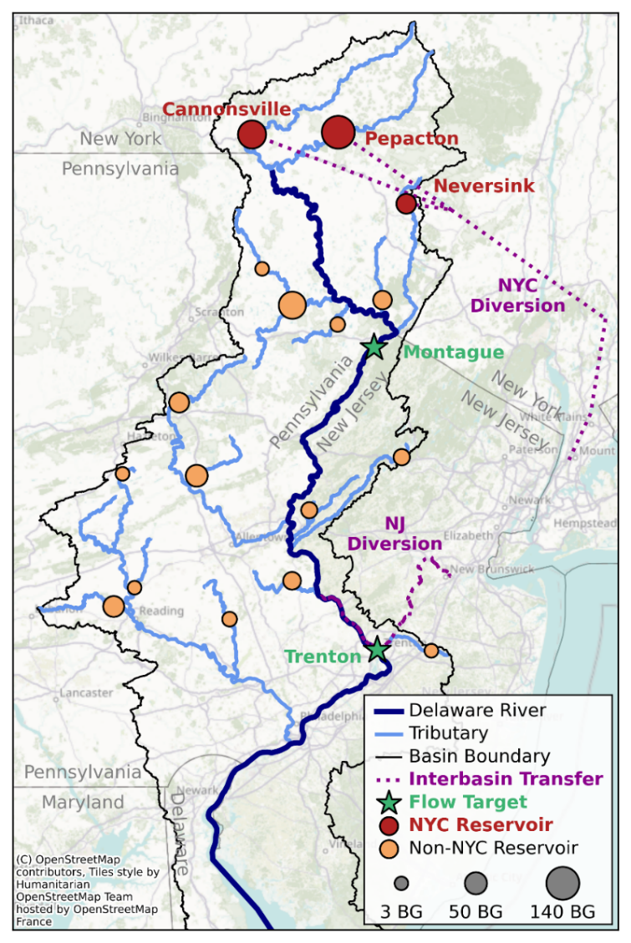
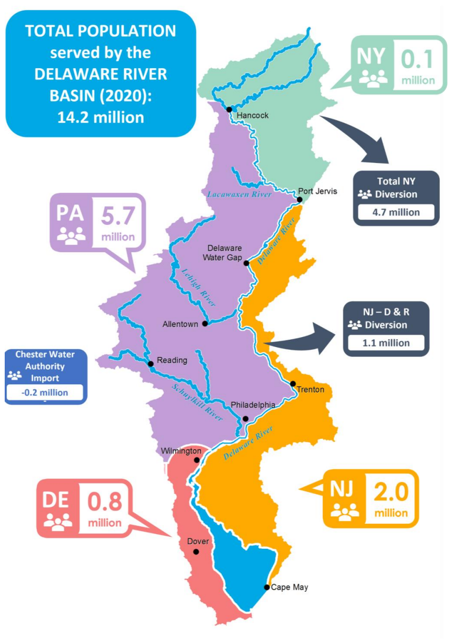
The Delaware River Basin (DRB)
Motivation | The Delaware River Basin | Pywr-DRB | Streamflow Reconstruction | Drought Vulnerability Assessment
Source: DRBC
Total population
served by the DRB (2020):
14.2 million

Slide 11
The Delaware River Basin (DRB)
Motivation | The Delaware River Basin | Pywr-DRB | Streamflow Reconstruction | Drought Vulnerability Assessment
Source: DRBC
Total population
served by the DRB (2020):
14.2 million
Significant trans-basin diversions:
New York City: 800 MGD
New Jersey: 100 MGD

Slide 12
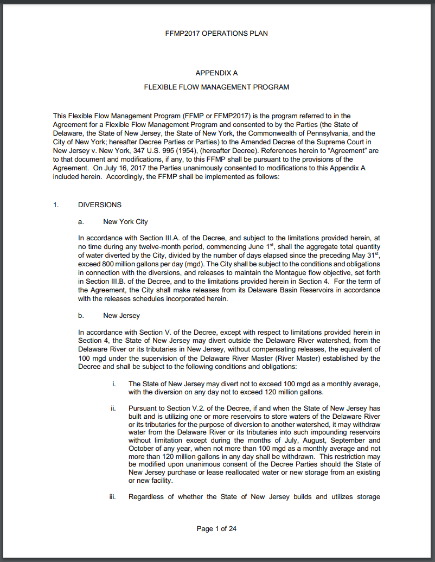
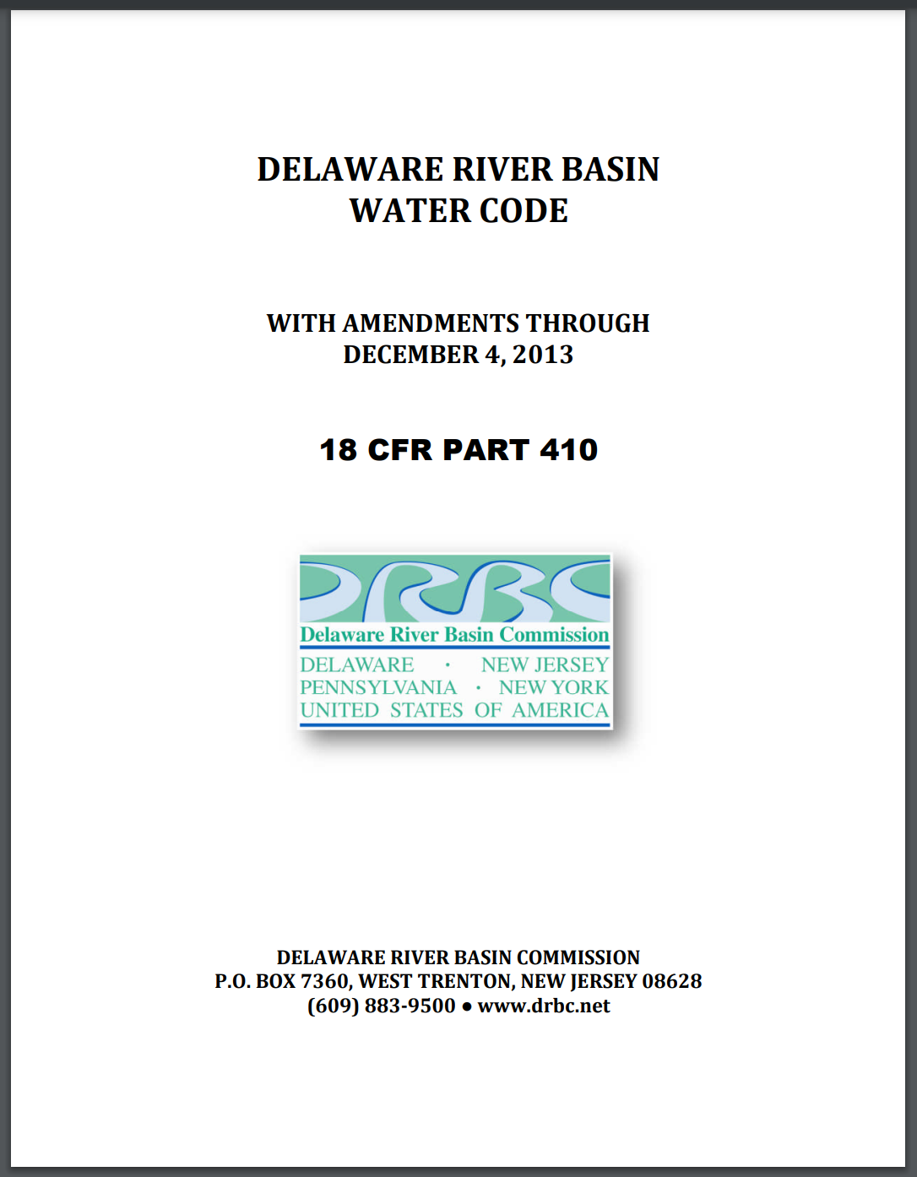
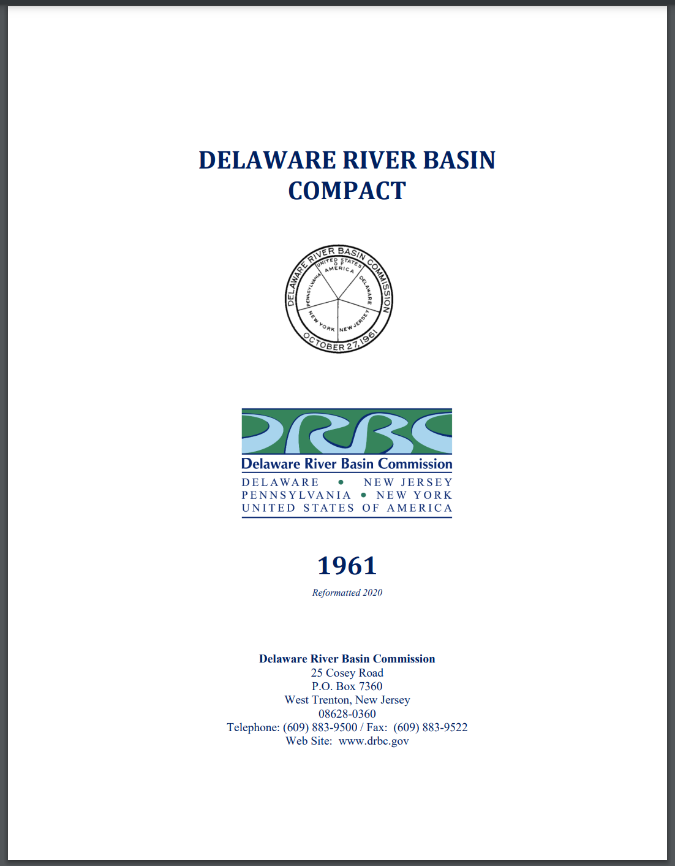
Water resource management policies
Motivation | The Delaware River Basin | Pywr-DRB | Streamflow Reconstruction | Drought Vulnerability Assessment
Policies governing management:
1961: Compact
Water Code
2017: Flexible Flow Management Program

Slide 13
Flexible Flow Management Program (FFMP)
Motivation | The Delaware River Basin | Pywr-DRB | Streamflow Reconstruction | Drought Vulnerability Assessment
FFMP provides basin-wide specifications for:
Reservoir releases
Max diversions (NYC & NJ)
Minimum flow objectives
Drought response
Flood mitigation
Salinity repulsion

Slide 14
Flexible Flow Management Program
Motivation | The Delaware River Basin | Pywr-DRB | Streamflow Reconstruction | Drought Vulnerability Assessment
NYC is required by the FFMP to make reservoir releases necessary to maintain downstream flow targets at:

Slide 15
Flexible Flow Management Program
Motivation | The Delaware River Basin | Pywr-DRB | Streamflow Reconstruction | Drought Vulnerability Assessment
NYC is required by the FFMP to make reservoir releases necessary to maintain downstream flow targets at:
Montague
Trenton

Slide 16
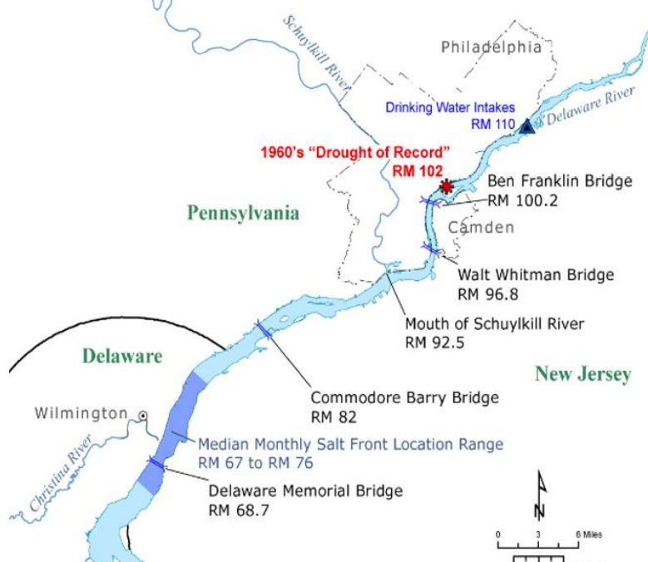
Flexible Flow Management Program
Motivation | The Delaware River Basin | Pywr-DRB | Streamflow Reconstruction | Drought Vulnerability Assessment
Streamflow targets at Trenton are designed to protect Philadelphia’s water supply from salinity intrusion.

Slide 17
Flexible Flow Management Program
Motivation | The Delaware River Basin | Pywr-DRB | Streamflow Reconstruction | Drought Vulnerability Assessment
Streamflow targets at Trenton are designed to protect Philadelphia’s water supply from salinity intrusion.
Philadelphia’s drinking water intake
“Salt front” location during 1960s drought.

Slide 18
Flexible Flow Management Program
Motivation | The Delaware River Basin | Pywr-DRB | Streamflow Reconstruction | Drought Vulnerability Assessment
Streamflow targets at Trenton are designed to protect Philadelphia’s water supply from salinity intrusion.
Prior to this work, there was
no open-source model for the basin, which prevented policy performance evaluation.
Philadelphia’s drinking water intake
Salt front location during 1960s drought.

Slide 19
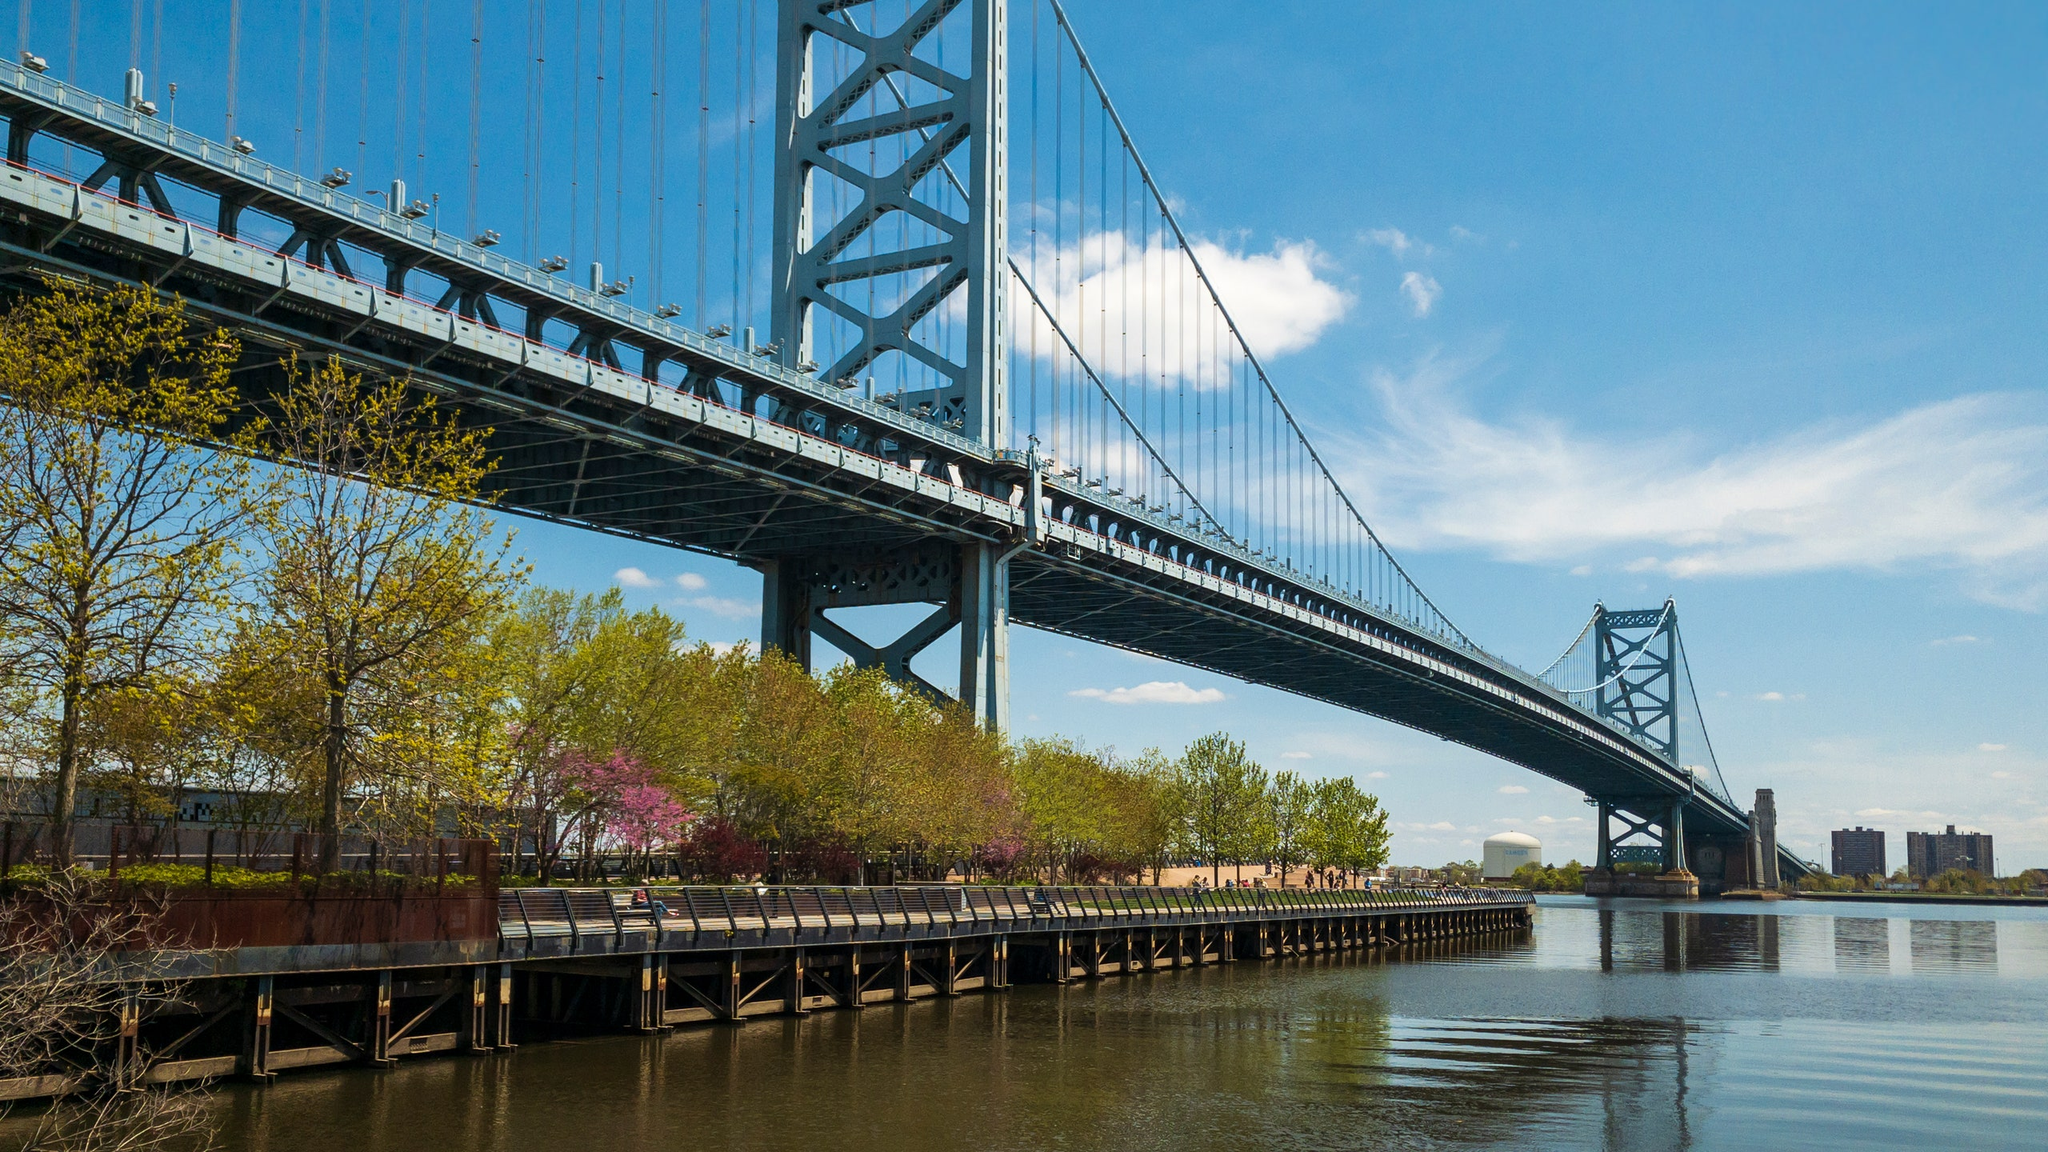
Pywr-DRB
Water Resource Systems Model
Photo credit: Jon Lovetta

Slide 20
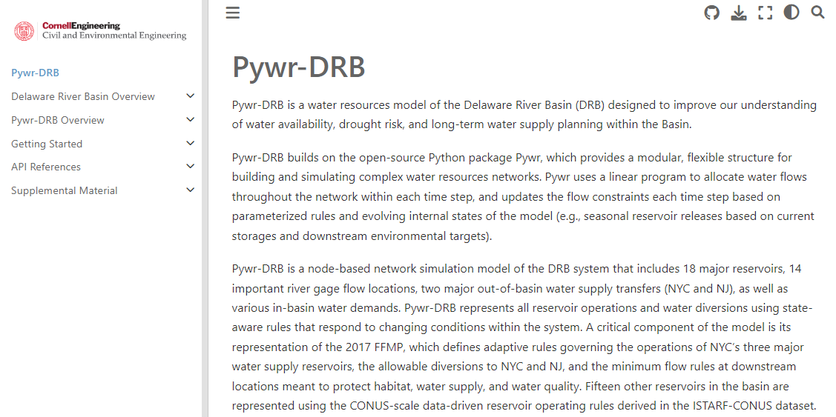
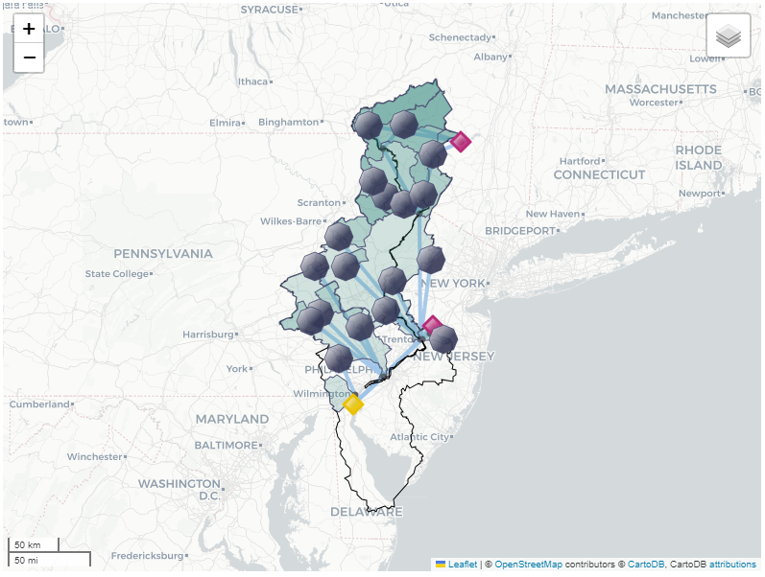
Open-Source Pywr-DRB
Motivation | The Delaware River Basin | Pywr-DRB | Streamflow Reconstruction | Drought Vulnerability Assessment
https://pywr-drb.github.io/Pywr-DRB/intro.html#

Slide 21
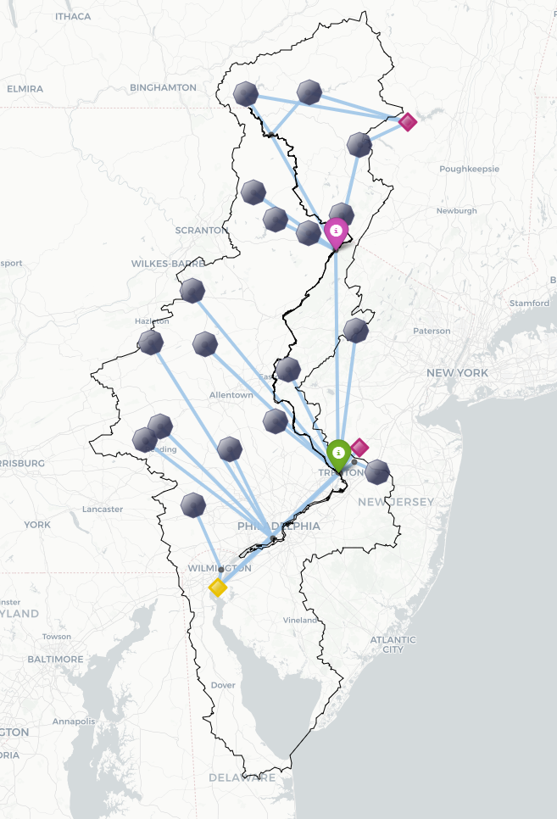
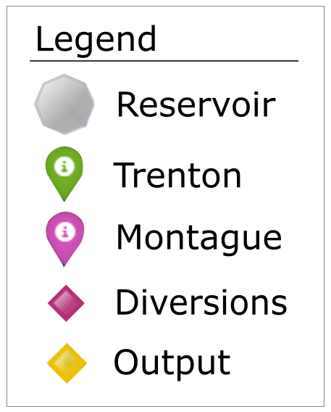
Pywr-DRB model structure
Motivation | The Delaware River Basin | Pywr-DRB | Streamflow Reconstruction | Drought Vulnerability Assessment
Components of Pywr-DRB:
Node-Edge Network
17 reservoirs
14 reaches of interest
Gages, flow targets, outlets
2 interbasin transfers

Slide 22
Pywr-DRB model structure
Motivation | The Delaware River Basin | Pywr-DRB | Streamflow Reconstruction | Drought Vulnerability Assessment
Components of Pywr-DRB:
Node-Edge Network
Reservoir operations
Catchment Inflows
Demands
Governance
Daily timestep

Slide 23
Pywr-DRB model structure
Motivation | The Delaware River Basin | Pywr-DRB | Streamflow Reconstruction | Drought Vulnerability Assessment
Components of Pywr-DRB:
Node-Edge Network
Reservoir operations
Catchment Inflows
Demands
Governance
Daily timestep
Catchment inflow & demand timeseries at nodes are the primary model input

Slide 24
Pywr-DRB model structure
Motivation | The Delaware River Basin | Pywr-DRB | Streamflow Reconstruction | Drought Vulnerability Assessment
Components of Pywr-DRB:
Node-Edge Network
Reservoir operations
Catchment Inflows
Demands
Governance
Daily timestep
Different levels of representation fidelity depending on decision relevance

Slide 25
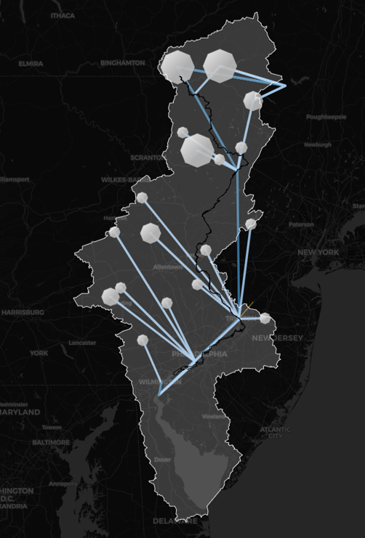
Pywr-DRB’s Role in Integrated Modeling
Motivation | The Delaware River Basin | Pywr-DRB | Streamflow Reconstruction | Drought Vulnerability Assessment
Managed Flows
Reservoir Storages
Diversions
Objective performance
Natural Flows

Slide 26
Pywr-DRB’s Role in Integrated Modeling
Motivation | The Delaware River Basin | Pywr-DRB | Streamflow Reconstruction | Drought Vulnerability Assessment
Managed Flows
Reservoir Storages
Diversions
Objective performance
Natural Flows
Where do these come from?

Slide 27
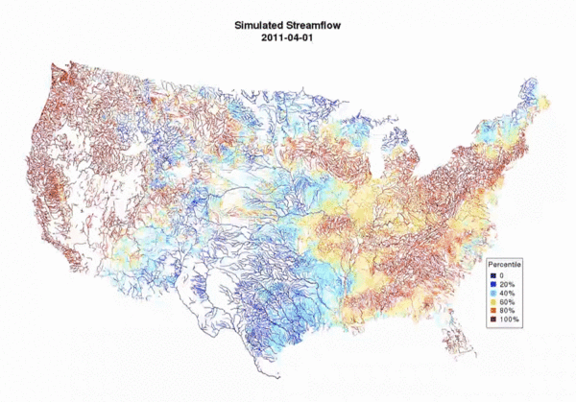
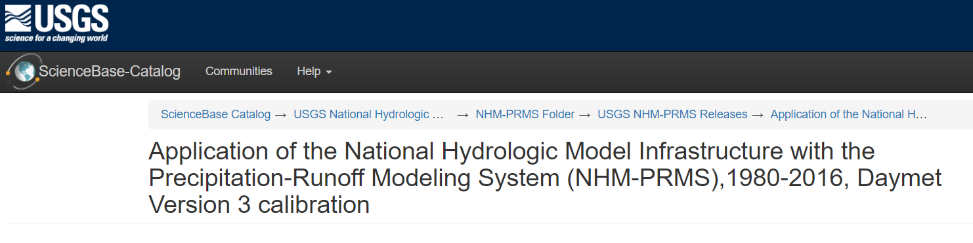
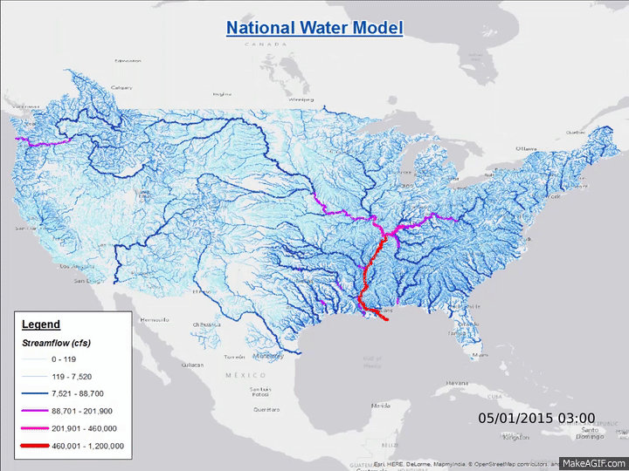
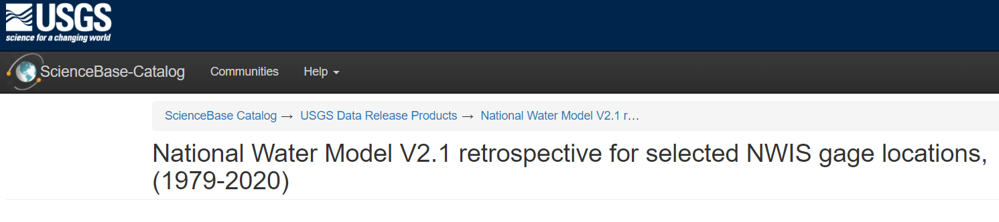
Pywr-DRB’s Role in Integrated Modeling
Motivation | The Delaware River Basin | Pywr-DRB | Streamflow Reconstruction | Drought Vulnerability Assessment
The National Hydrologic Model (NHM)
The National Water Model (NWM)

Slide 28
Pywr-DRB’s Role in Integrated Modeling
Motivation | The Delaware River Basin | Pywr-DRB | Streamflow Reconstruction | Drought Vulnerability Assessment
The National Hydrologic Model (NHM)
Managed Flows
Reservoir Storages
Diversions
Objective performance
The National Water Model (NWM)

Slide 29
Pywr-DRB’s Role in Integrated Modeling
Motivation | The Delaware River Basin | Pywr-DRB | Streamflow Reconstruction | Drought Vulnerability Assessment
The National Hydrologic Model (NHM)
Managed Flows
Reservoir Storages
Diversions
Objective performance
The National Water Model (NWM)
Future Climate Scenarios
Historic Reconstructions

Slide 30
Historic streamflow reconstruction
Motivation | The Delaware River Basin | Pywr-DRB | Streamflow Reconstruction | Drought Vulnerability Assessment
Captures the drought of record
NHMv1.0 (1983 – 2016)
1960s
Drought
NWMv2.1 (1983 – 2020)
1950
1960
1970
1980
1990
2000
2010
2020

Slide 31
Historic streamflow reconstruction
Motivation | The Delaware River Basin | Pywr-DRB | Streamflow Reconstruction | Drought Vulnerability Assessment
Captures the drought of record
NHMv1.0 (1983 – 2016)
1960s
Drought
NWMv2.1 (1983 – 2020)
Historic Reconstruction (1945 – 2023)
1950
1960
1970
1980
1990
2000
2010
2020

Slide 32
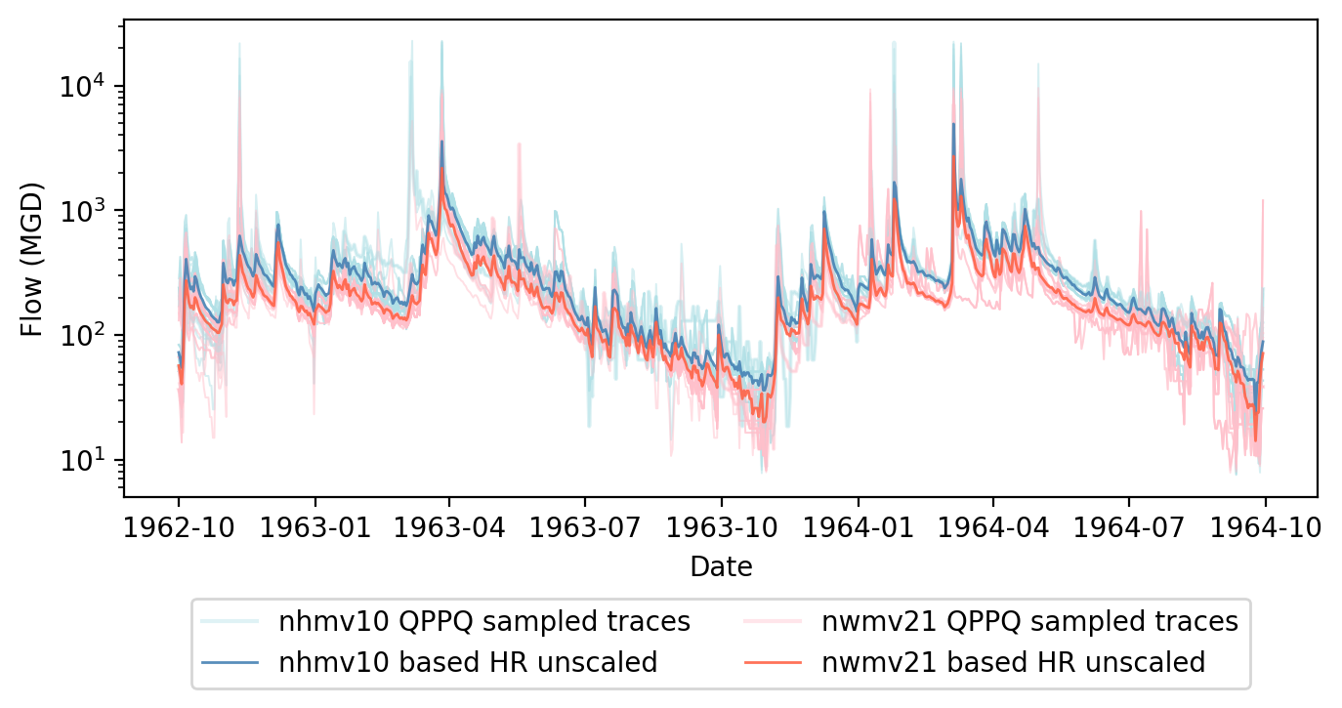
Historic streamflow reconstruction
Motivation | The Delaware River Basin | Pywr-DRB | Streamflow Reconstruction | Drought Vulnerability Assessment
Captures the drought of record
Account for uncertainty using probabilistic predictions

Slide 33
Pywr-DRB’s Role in Integrated Modeling
Motivation | The Delaware River Basin | Pywr-DRB | Streamflow Reconstruction | Drought Vulnerability Assessment
The National Hydrologic Model (NHM)
Managed Flows
Reservoir Storages
Diversions
Objective performance
The National Water Model (NWM)

Slide 34
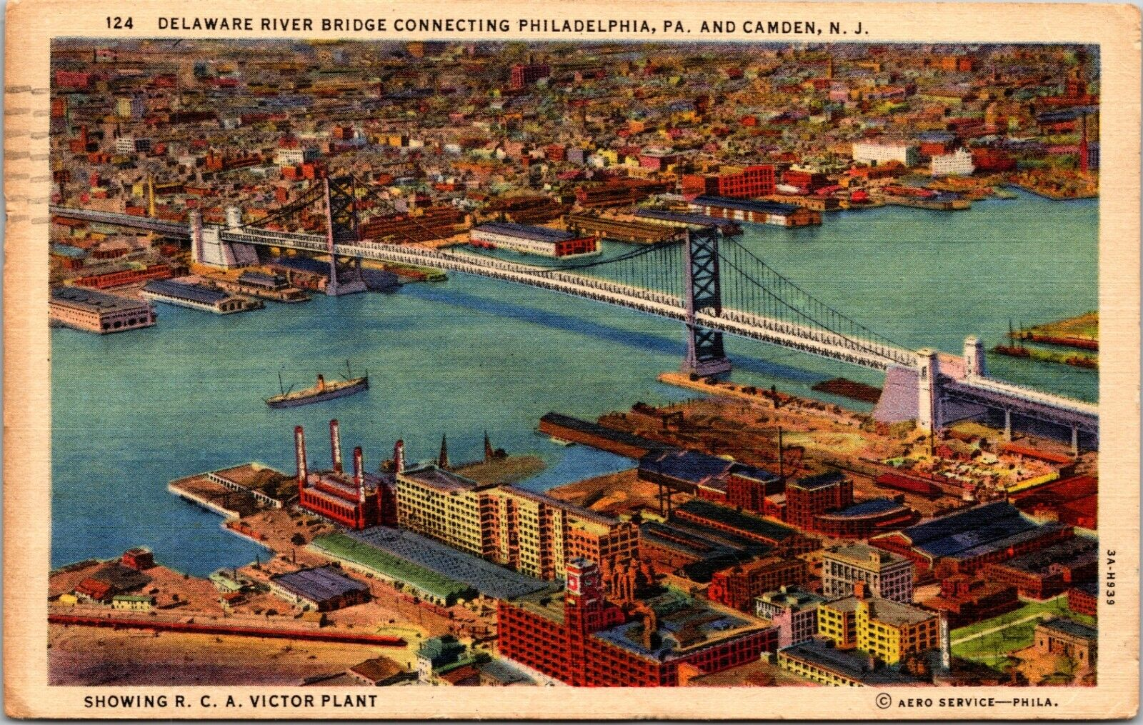
Results:
Simulation during modern period
Photo credit: Aero Service Corporation

Slide 35
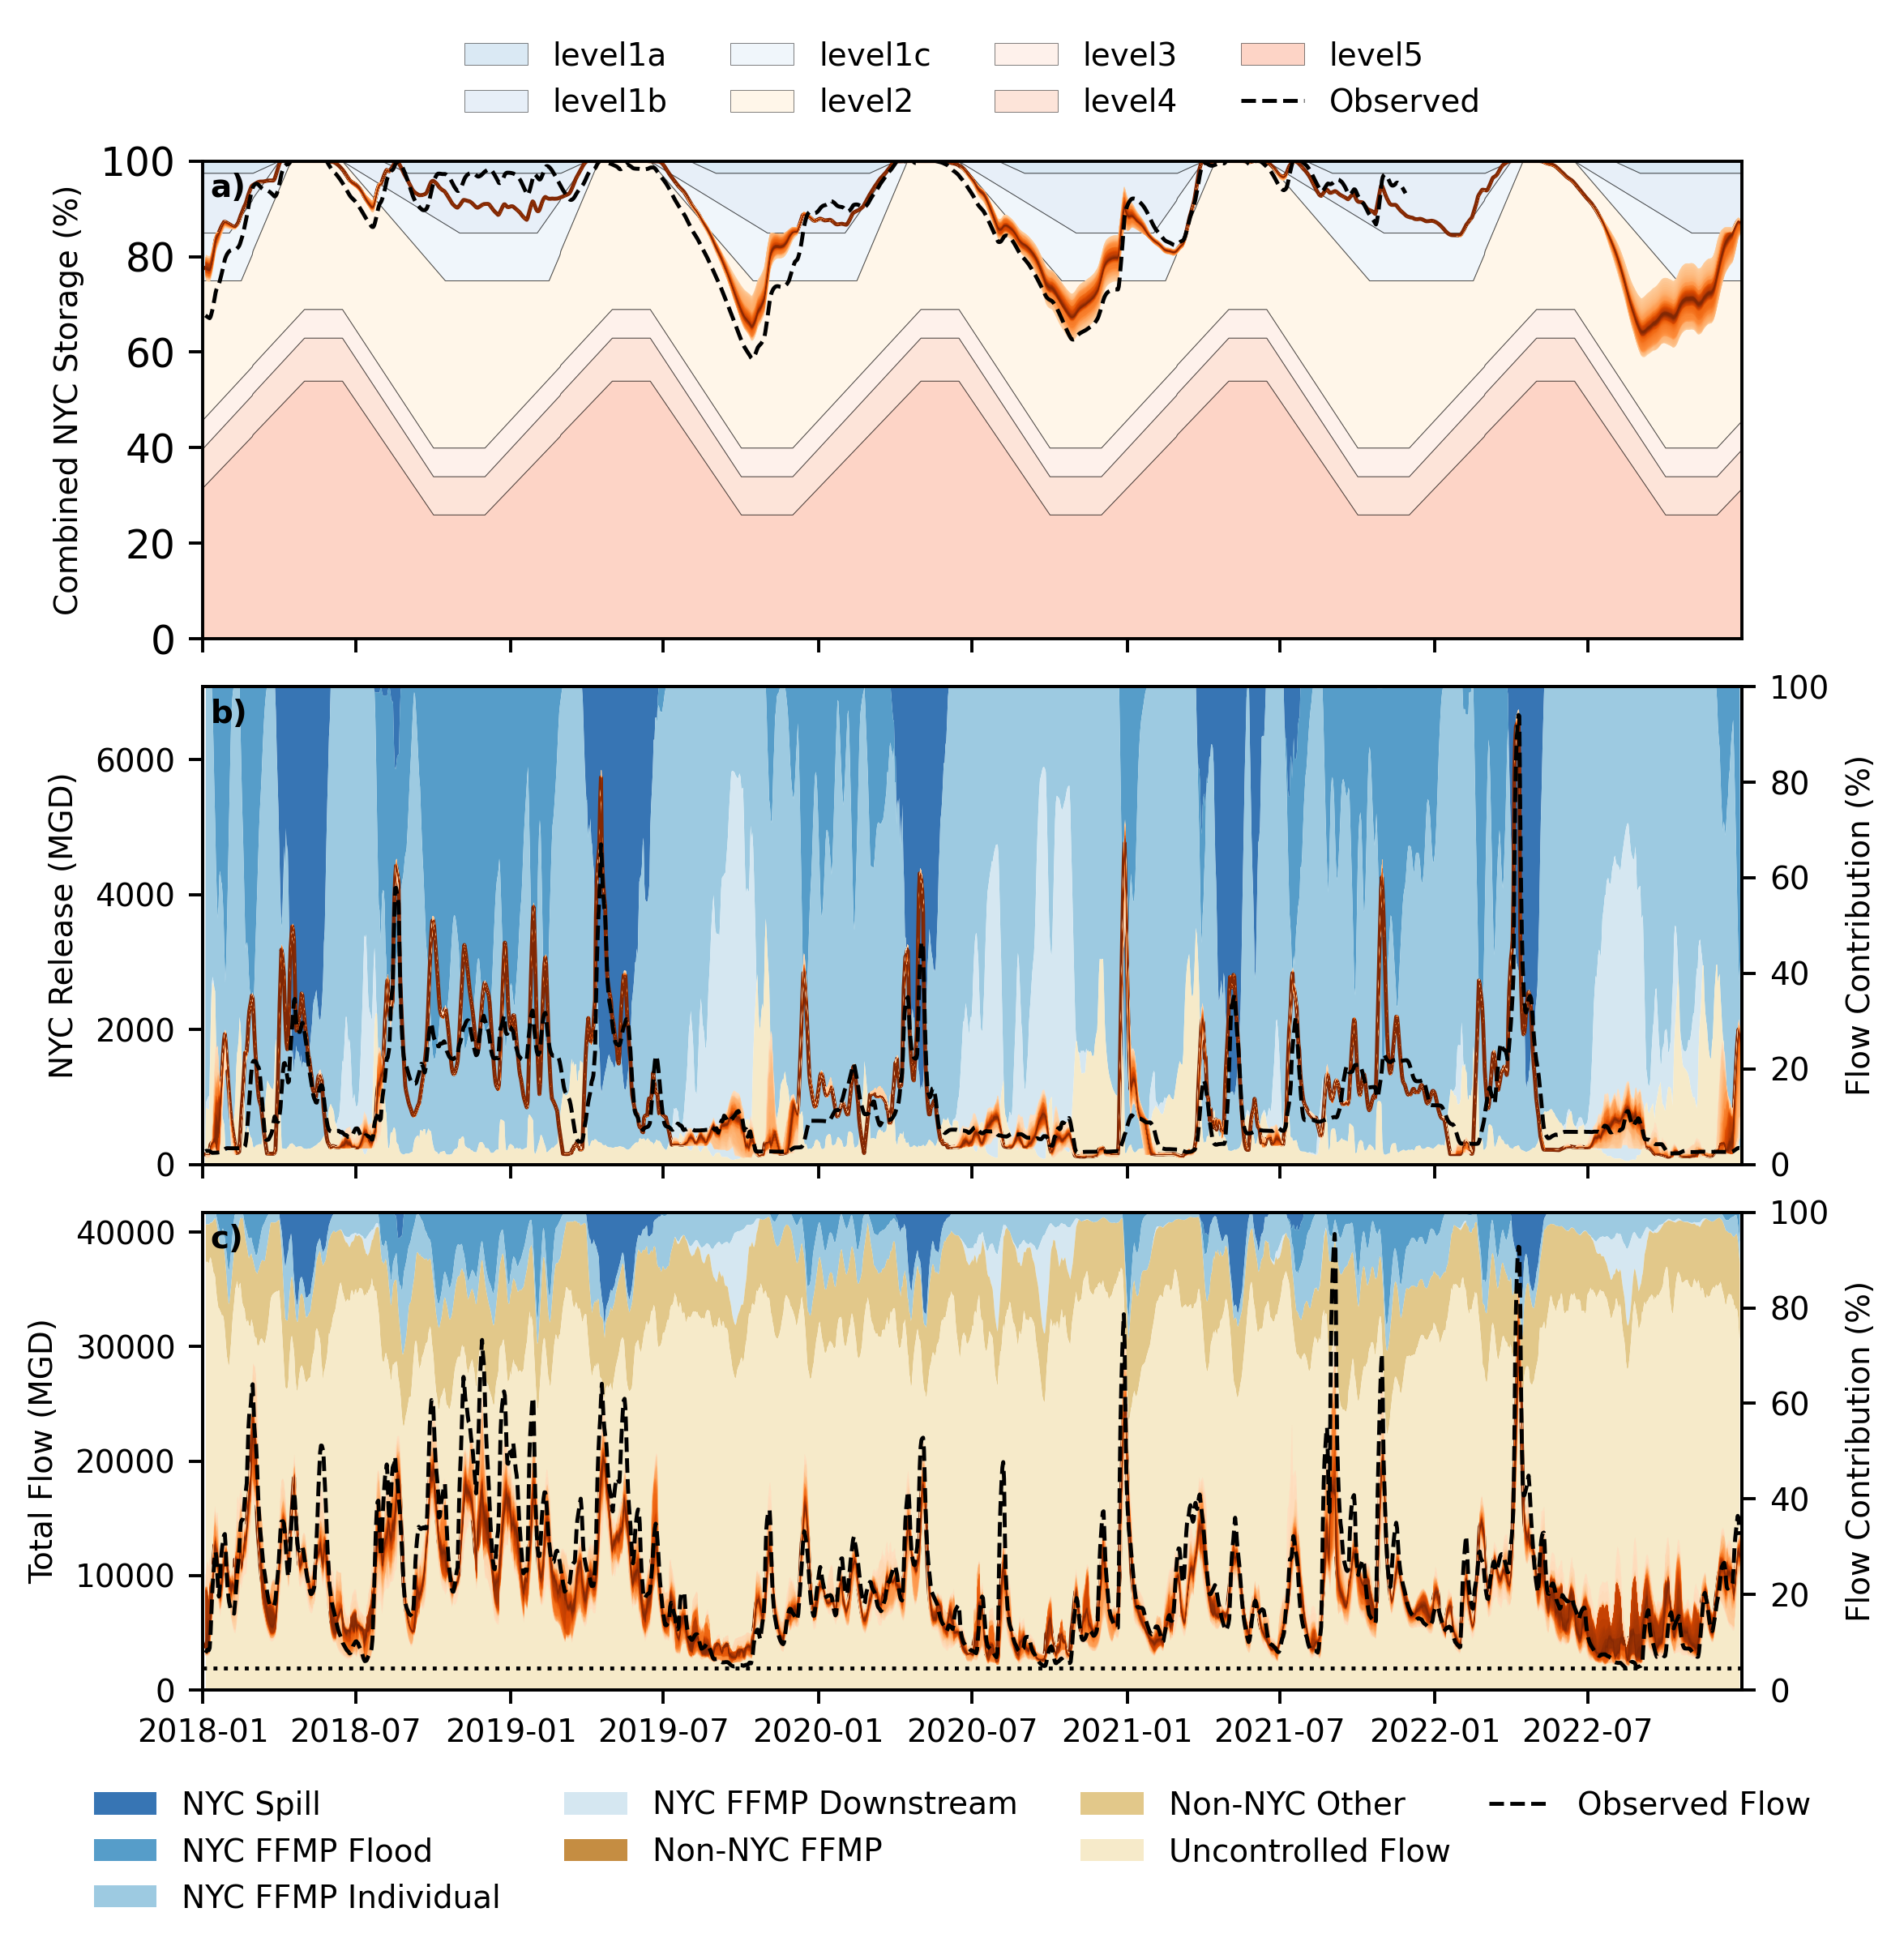
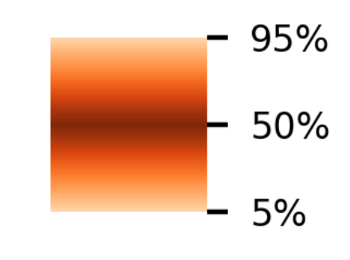
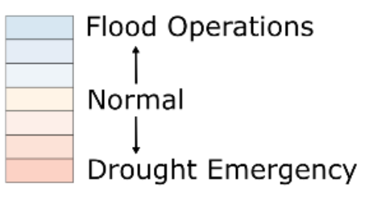
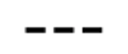
Simulation of post-FFMP period with Pywr-DRB
Motivation | The Delaware River Basin | Pywr-DRB | Streamflow Reconstruction | Drought Vulnerability Assessment
NYC total combined storage
Ensemble
Distribution
NYC Combined Storage (%)
Observed
Total flow downstream,
flow target location
Trenton Flow
(MGD)

Slide 36
Simulation of post-FFMP period with Pywr-DRB
Motivation | The Delaware River Basin | Pywr-DRB | Streamflow Reconstruction | Drought Vulnerability Assessment
Ensemble
Distribution
NYC Combined Storage (%)
Observed
Total flow downstream,
flow target location
Trenton Flow
(MGD)
Pywr-DRB tracks observed storage & releases well in modern period.

Slide 37
Simulation of post-FFMP period with Pywr-DRB
Motivation | The Delaware River Basin | Pywr-DRB | Streamflow Reconstruction | Drought Vulnerability Assessment
Ensemble
Distribution
NYC Combined Storage (%)
Observed
Total flow downstream,
flow target location
Trenton Flow
(MGD)
What is happening downstream during this time?

Slide 38
Simulation of post-FFMP period with Pywr-DRB
Motivation | The Delaware River Basin | Pywr-DRB | Streamflow Reconstruction | Drought Vulnerability Assessment
Ensemble
Distribution
NYC Combined Storage (%)
Observed
Flow sources:
Trenton Flow
(MGD)
Flow
Contributions (%)

Slide 39
Simulation of post-FFMP period with Pywr-DRB
Motivation | The Delaware River Basin | Pywr-DRB | Streamflow Reconstruction | Drought Vulnerability Assessment
Ensemble
Distribution
NYC Combined Storage (%)
Observed
Flow sources:
Trenton Flow
(MGD)
Flow
Contributions (%)
Background color = where the flow came from.
Blue: New York City Reservoirs
Brown: Somewhere else

Slide 40
Simulation of post-FFMP period with Pywr-DRB
Motivation | The Delaware River Basin | Pywr-DRB | Streamflow Reconstruction | Drought Vulnerability Assessment
Ensemble
Distribution
NYC Combined Storage (%)
Observed
Flow sources:
Trenton Flow
(MGD)
Flow
Contributions (%)
Trenton minimum flow target
specified by the FFMP.

Slide 41
Simulation of post-FFMP period with Pywr-DRB
Motivation | The Delaware River Basin | Pywr-DRB | Streamflow Reconstruction | Drought Vulnerability Assessment
Ensemble
Distribution
NYC Combined Storage (%)
Observed
Flow sources:
Trenton Flow
(MGD)
Flow
Contributions (%)
Approaches the minimum flow target 3 times.

Slide 42
Simulation of post-FFMP period with Pywr-DRB
Motivation | The Delaware River Basin | Pywr-DRB | Streamflow Reconstruction | Drought Vulnerability Assessment
Ensemble
Distribution
NYC Combined Storage (%)
Observed
Flow sources:
Trenton Flow
(MGD)
Flow
Contributions (%)
NYC reservoir releases are 20-25% of total Trenton flow during the low-flow periods.

Slide 43
Simulation of post-FFMP period with Pywr-DRB
Motivation | The Delaware River Basin | Pywr-DRB | Streamflow Reconstruction | Drought Vulnerability Assessment
Ensemble
Distribution
NYC Combined Storage (%)
Observed
Flow sources:
Trenton Flow
(MGD)
Flow
Contributions (%)
Dips in NYC storage correspond to periods when NYC needs to sustain downstream targets.

Slide 44
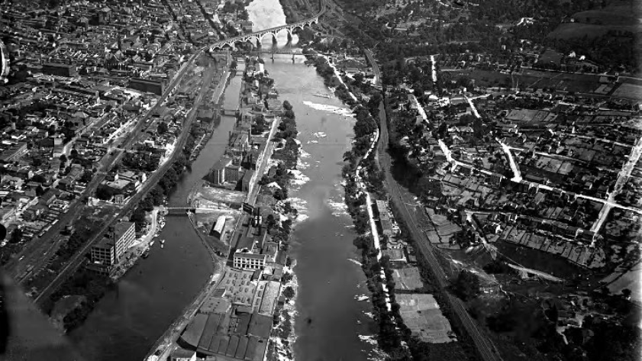
Assessing current management
policies under reconstructed
1960s drought
Image credit: Aero Service Corporation

Slide 45
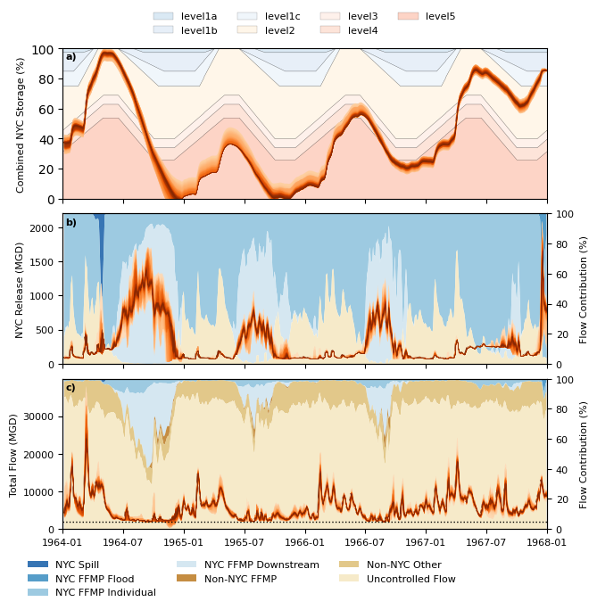
Simulation of 1960s drought
Motivation | The Delaware River Basin | Pywr-DRB | Streamflow Reconstruction | Drought Vulnerability Assessment
NYC total combined storage
Ensemble
Distribution
NYC Combined Storage (%)
Flow sources:
Total flow downstream,
flow target location
Trenton Flow
(MGD)
Flow
Contributions (%)

Slide 46
Simulation of 1960s drought
Motivation | The Delaware River Basin | Pywr-DRB | Streamflow Reconstruction | Drought Vulnerability Assessment
NYC total combined storage
Ensemble
Distribution
NYC Combined Storage (%)
Flow sources:
Trenton Flow
(MGD)
Flow
Contributions (%)

Slide 47
Simulation of 1960s drought
Motivation | The Delaware River Basin | Pywr-DRB | Streamflow Reconstruction | Drought Vulnerability Assessment
NYC total combined storage
Ensemble
Distribution
NYC Combined Storage (%)
Flow sources:
Trenton Flow
(MGD)
Flow
Contributions (%)
NYC reservoir releases are 60% of flow at Trenton during most extreme drought conditions!

Slide 48
Simulation of 1960s drought
Motivation | The Delaware River Basin | Pywr-DRB | Streamflow Reconstruction | Drought Vulnerability Assessment
NYC total combined storage
Ensemble
Distribution
NYC Combined Storage (%)
Flow sources:
Trenton Flow
(MGD)
Flow
Contributions (%)
What happens to NYC storage during this drought?

Slide 49
Simulation of 1960s drought
Motivation | The Delaware River Basin | Pywr-DRB | Streamflow Reconstruction | Drought Vulnerability Assessment
Ensemble
Distribution
NYC Combined Storage (%)
Flow sources:
Trenton Flow
(MGD)
Flow
Contributions (%)

Slide 50
Simulation of 1960s drought
Motivation | The Delaware River Basin | Pywr-DRB | Streamflow Reconstruction | Drought Vulnerability Assessment
Ensemble
Distribution
NYC Combined Storage (%)
Flow sources:
Trenton Flow
(MGD)
Flow
Contributions (%)
Critical storage drawdown occurs quickly from July to December under 1964 drought conditions

Slide 51
Simulation of 1960s drought
Motivation | The Delaware River Basin | Pywr-DRB | Streamflow Reconstruction | Drought Vulnerability Assessment
Ensemble
Distribution
NYC Combined Storage (%)
Flow sources:
Trenton Flow
(MGD)
Flow
Contributions (%)
Large FFMP-required downstream contributions…
…lead to severe NYC storage emergency!

Slide 52
Simulation of 1960s drought
Motivation | The Delaware River Basin | Pywr-DRB | Streamflow Reconstruction | Drought Vulnerability Assessment
Ensemble
Distribution
NYC Combined Storage (%)
Flow sources:
Trenton Flow
(MGD)
Flow
Contributions (%)
Significant tension exists between NYC’s storage reliability and downstream minimum flow objectives.

Slide 53
Future work
Motivation | The Delaware River Basin | Pywr-DRB | Streamflow Reconstruction | Drought Vulnerability Assessment
Explore system performance under a wide range of different drought conditions
Identify optimal reservoir operations that are more reliable under extreme droughts

Slide 54
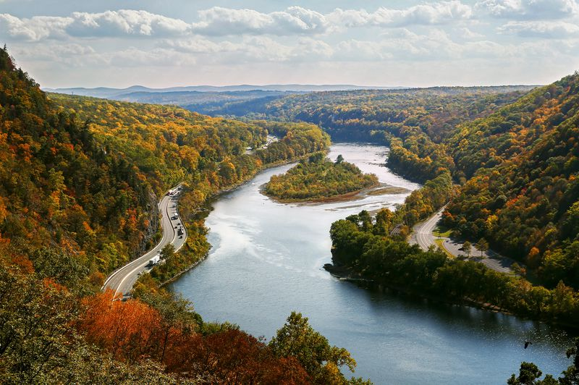
Thanks for listening!
Any questions?
Links:
TJA73@cornell.edu
Pywr-DRB GitHub: https://github.com/Pywr-DRB/Pywr-DRB
Documentation: https://pywr-drb.github.io/Pywr-DRB/intro.html

